Slide 1
Présentation TP 5
Présenté par: PENENGE TEBANDIME Lionel

Slide 2
Classe CPU
Cette classe représente un processeur physique.
using System;
using System.Timers;
/// <summary>
/// This class represents the hardware CPU
/// </summary>
public class CPU : ITimeTickReceiver
{
/// <summary>
/// The Process currently running on the CPU
/// </summary>
private IProcess current = null;
/// <summary>
/// The Scheduler
/// </summary>
private Scheduler scheduler;
/// <summary>
/// Make the scheduler known to the CPU
/// </summary>
/// <param name="scheduler"> The Scheduler</param>
public Scheduler Scheduler
{
set
{
this.scheduler = value;
}
}
Classe Planificateur
Cette classe planifie les processus sur le CPU.
Classe CircularProcesList
Cette classe implémente une liste circulaire. Elle est utilisée par l'ordonnanceur comme une file d'attente pour contenir les processus.
using System.Collections.Generic;
/// <summary>
/// This class implements a circular list using the LinkedList class
/// Note that elements in a LinkedList with n elements are numbered 0 .. (n-1)
/// </version>
public class CircularProcesList
{
private LinkedList<IProcess> list;
/// <summary>
/// Creates a new LinkedList to contain Testproces-ses
/// </summary>
public CircularProcesList()
{
this.list = new LinkedList<IProcess>();
}

Slide 3
Classe HardWareTimer.
using System;
using System.Timers;
public class HardwareTimer : Timer
{
/// <summary>
/// Counting the number of millisecs
/// </summary>
public long Clock = 0;
/// <summary>
/// The length of the timer interval in milliseconds
/// </summary>
public const long TickLength = 100;
public HardwareTimer()
{
this.Interval = TickLength;
}
/// <summary>
/// Adds an ITimeTickReceiver to the list
/// </summary>
/// <param name="receiver">The ITimeTickReceiver to be added</param>
public void AddTickReceiver(ITimeTickReceiver receiver)
{
if (receiver != null)
{
this.Elapsed += receiver.ReceiveTimeTick;
}
}
Classe ITimeTickReceiver
Interface pour les classes qui veulent recevoir les tics de minuterie de l'application
using System;
using System.Timers;
/// <summary>
/// Interface to be implemented by receivers of ticks of the HardwareTimer
/// </summary>
public interface ITimeTickReceiver
{
/// <summary>
/// This method is called when a timertick occurs
/// </summary>
/// <param name="clock">number of current timertick</param>
void ReceiveTimeTick(object source, ElapsedEventArgs e);
}

Slide 4
L'interface qui doit être implémentée par les processus qui s'exécutent sur le simulateur. TestProces
La classe pour les processus qui s'exécutent sur le CPU simulé. Cette classe implémente l'interface IProcess.
Classe SchedulerMain
using System;
using System.Threading;
/// <summary>
/// This program demonstrates how the scheduler operates.
/// This creates the CPU, scheduler and timer, and then the three example processes.
/// </summary>
public class SchedulerMain
{
public static void Main(System.String[] args)
{
// Create virtual computer
CPU singleCPU = new CPU();
Scheduler CPUScheduler = new Scheduler(singleCPU);
HardwareTimer timer = new HardwareTimer();
// Add hardware components to hardware timer
Classe IProces
using System;
using System.Collections.Generic;
using System.Text;
using System.Timers;
public interface IProcess : ITimeTickReceiver
{
string Name { get; set; }
bool Ready { get; }
long TurnAroundTime { get; }
long WaitingTime { get; }
long InitialCPUTimeNeeded { get; }
long StartTime { set; }
}

Slide 5
this.currentCPU = cpu
timeSlice = DEFAULT_TIME_SLICE
this.timeSliceCounter = 0
queue = new CircularProcesList()
cpu.Scheduler = this
public Scheduler(CPU cpu, int quantum)
: this(cpu)
timeSlice = quantum
/// <summary>
/// The average turnaround time of all processes that finished up to now
/// </summary>
public NoProcesses As bool
Code modifié
ImportsSystem.Timers;
/// <summary>
/// The scheduler
/// </summary>
public class Scheduler : ITimeTickReceiver
private currentCPU As CPU
private queue As CPU CircularProcesList
private timeSlice As long
private As timeSliceCounter long
private const DEFAULT_TIME_SLICE As integer = 2000
private clock As long =0
public Scheduler(CPU cpu)

Slide 6
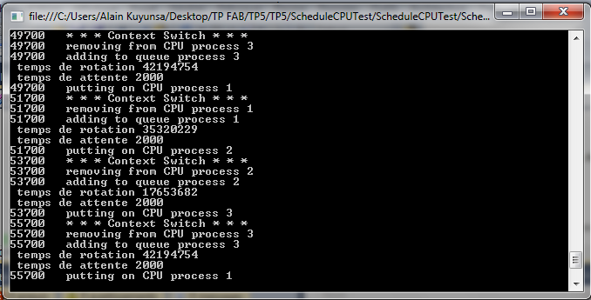
Code developpé
Imports System.Timers
Imports System
/// <summary>
/// A process that will be executed by the CPU
/// </summary>
public class TestProcess : IProcess
private name As string
private ready As bool = false
private cpuTimeNeeded As long // Amount of CPU time needed to finish execution
private clock As long // The current time in this simulator
private startTime = -1 As long
private ta As long
private tr As long
private init As long
/// <summary>
/// Creates a process with a name and the amount of timerticks needed to finish execution
/// </summary>
/// <param name="id">name of the process</param>
/// <param name="processtime">amount of timerticks needed to finish execution</param>
public TestProcess(string id, long processtime, long tempR,long tempA,long InitCPU)
this.Name = id
this.cpuTimeNeeded = processtime
this.TurnAroundTime = tempR
this.WaitingTime = tempA
this.InitialCPUTimeNeeded = InitCPU

